Slide 1
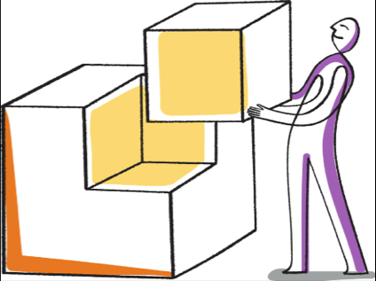
System decomposition
A process of breaking down a system into its component subsystems, analyzing each separately and then aggregating them back into the complex system.
Reduces complexity
Identifies system boundaries

Slide 2
System
User registration subsystem
Service search subsystem
Business page manager
Business registration subsystem

